Slide 1
Artificially Intelligent System
Machine Learning, Speech & Voice Recognition, Virtual Assistant

Slide 2

Notes:
This program will be able to implement Machine Learning, this program will be able to recognize Speech & Voice , this program will be able to use goggle, amazon, Seri to answer anything and virtually assist the users. Users can use this program in their code to achieve any AI Or machine learning related tasks. This program can be a plug in or a software itself which can be downloaded on android, apple and can be access trough a website. AI and machine learning is the future of technology and this software will enable all the people to test the true benefit.

Slide 3
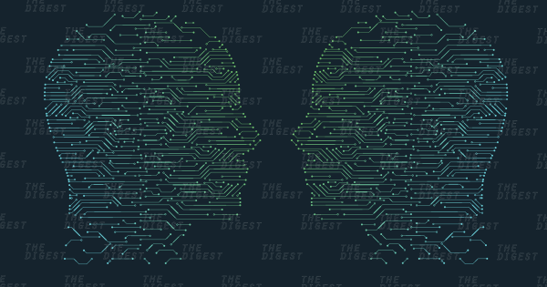
A system that can be installed in a robot or other custom build machines to implement machine learning, image recognition , natural language processing, Speech & Voice Recognition and Virtual Assistance.
We are creating a system to build and maintain an AI app. This system will be broken down into Configuring system, Building Process Review, Maintenance
Notes:
We are thinking about the future, we are trying to take humanity a step close to the future. These are the reasons behind building this software. “Our technology, our machines, is part of our humanity,” author, computer scientist, and inventor Ray Kurzweil once said. “We created them to extend ourselves, and that is what is unique about human beings.”
Source -https://www.forbes.com/sites/cognitiveworld/2018/10/01/human-2-0-is-coming-faster-than-you-think-will-you-evolve-with-the-times/#4a597a264284

Slide 4
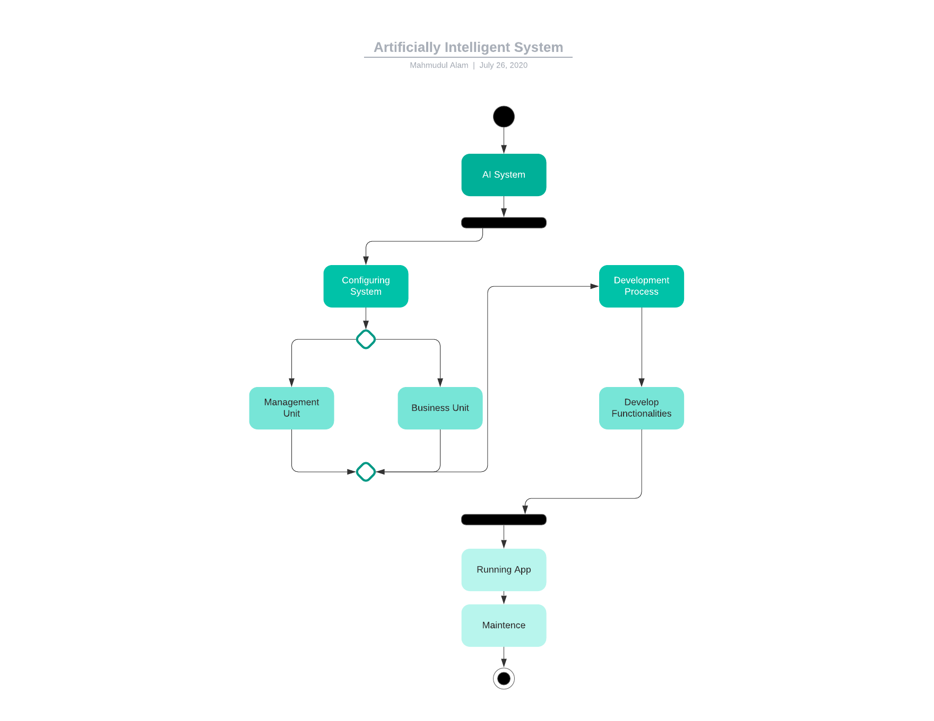
Notes:
AI System is the name of the app. We are going to explain how the whole development process will take place. At first, we are going to configure the systems, which will be broken down into two category. Management Unit and the Business unit. Our product is that AI Application, but we need business strategy and the management team to hire people and keep the system running smoothly. Once we have our business running smoothly, we can start the development process. Eventually we can have a running Application. Once the app is running at the maintenance stage, we will focus on running the app smoothly with updates and based on the business revenue we will add new features to the software.

Slide 5
Configuring system
4 programmers, 1 project manager
2 HR personal, 2 Business Analyst
Content DNA Platform- Machine Learning/Computer Vision.
Google Cloud Machine Learning Engine
TensorFlow
Google Assistant
Python specialist, integration specialist
Notes:
We are building the company from scratch therefore we must configure the whole system. The software we are going to build will require 4 programmers under one manager. 2HR personals and two business analyst. Configuring the whole system will also bring us to the platform we are going to use to build our software. As part of that we are going to have google cloud machine learning, TensorFlow, google assistance.

Slide 6
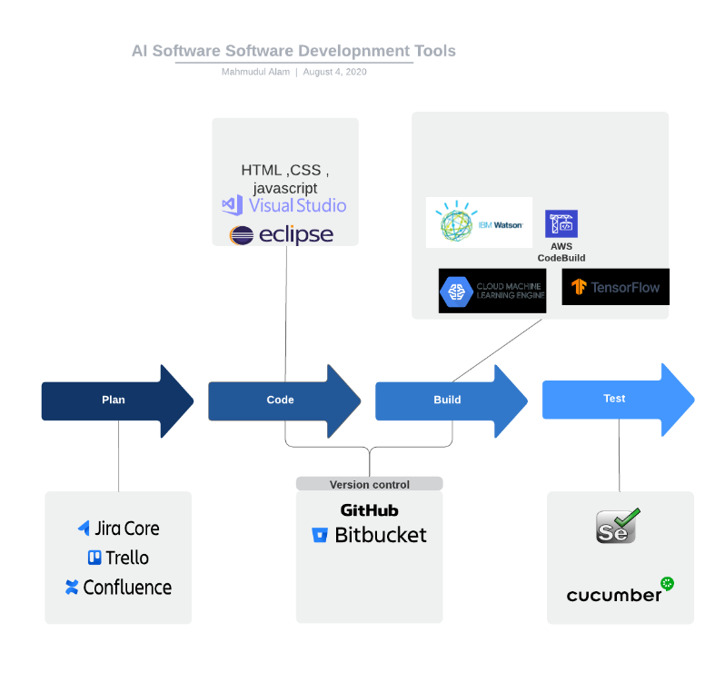
Configuring Tools
HTML
CSS
JavaScript
JIRA
GitHub
IBM Watson
Google Machine Learning Engine
TenserFlow
Notes:
We are going to use JIRA to keep track of the development progress. Keep track of the scrum teams. On the next phase of the process when we start writing the code for the front-end section of the application, we are going to use HTML,CSS and JavaScript. IDE is based on the preference of the programmers and the development team. They can decide based on the programming need, but recommended IDE’s are eclipse and Visual Studio. Once we have a running program, we are going to intricate Google's cloud machine learning and IBM’s Watson, TensorFlow to have Machine learning AI capabilities. Once that is done, we are going to test the application using selenium and cucumber.

Slide 7
Management Unit
Hire The required personals
Manage both business unit and employees.
Internal budgeting.
Planning
Tracking and management
IT project managenment
Notes:
HR and project manager is part of this hiring team. HR will take care of the paper works and payroll and other benefits related issues. Manager is going to oversee the planning, tracking and management. Planning is an import part of any project; without proper plans no project can be successful. Management unit will make sure everything is running smoothly so each sector of the company can focus on their part of the software development.

Slide 8
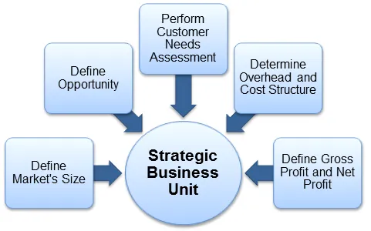
Business Unit
Promoting the business
Collecting sponsorships
Selling the product
Notes:
The business team will oversee the strategic planning based on customer demand and business need. Strategic business unit is the eyes an ear for a business, they guides the company the proper way with the economic standing and fills the gap between the company and customers by performing customer need assessments and by defining the market size.

Slide 9
Configuring Scope
Each Scope will be based on the task despite how much time is required. When we are System integrating Googles Machine learning to our software we will only focus on that feature. We will make our sprints based on the work requirements. Other Scopes will be approached and created based on the time and tolls required for that specific feature.
Notes:
Scope is the building blocks for every project. We will determine how much work needs to be done for certain part of the project at a certain moment. Also the to establish a timeline for the delivery date for the final project scope plays an important role.

Slide 10
Scope Management
Planning scope
Collecting requirements
Defining scope
validating scope
Control
Monitor
Notes:
We are going to analyze the scope to determine exactly what are the outcomes/goal for this specific scope. By analyzing and keeping track of the scope we can regulate scope creeping.

Slide 11
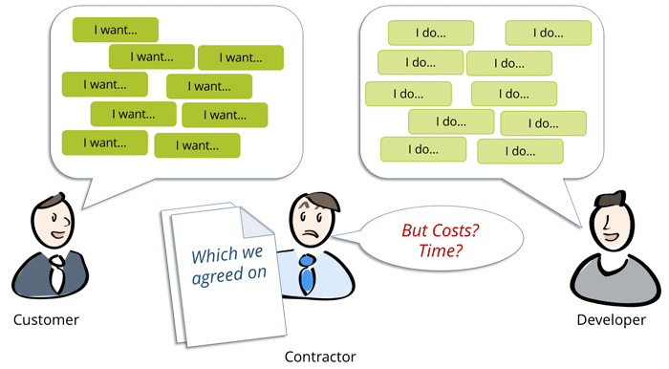
Scope Creep Policy
If there is last minute adjustment to the scope we will use the extra time included in each scope. We will have a extra week with scope to deal with scope creeping , if there is no scope creeping that time will be used for testing purposes.
Notes:
The picture has clickable link to more information about scope creep.

Slide 12
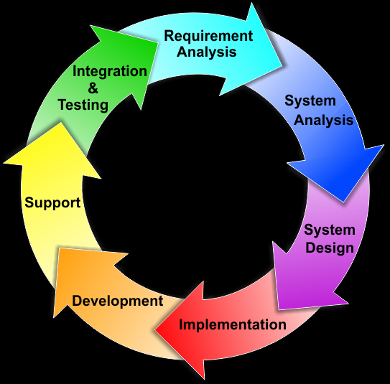
Development Process
Schedule
Schedule The project on Agile
Have
Have a monthly meeting with the whole organization.
Update and keep
Contently update and keep the requirements up to date to keep up with the market current technologies.
Build
Build the platform first then integrate other services in to the software.
Notes:
We are going to break down the project into small scopes based on the requirement. Project manager will oversee the development planning, communicating and making sure the scope is finished with the desired result based on the requirements. Every scope will start with requirement analysis, system analysis, system design, implementation, development and finish with testing.

Slide 13
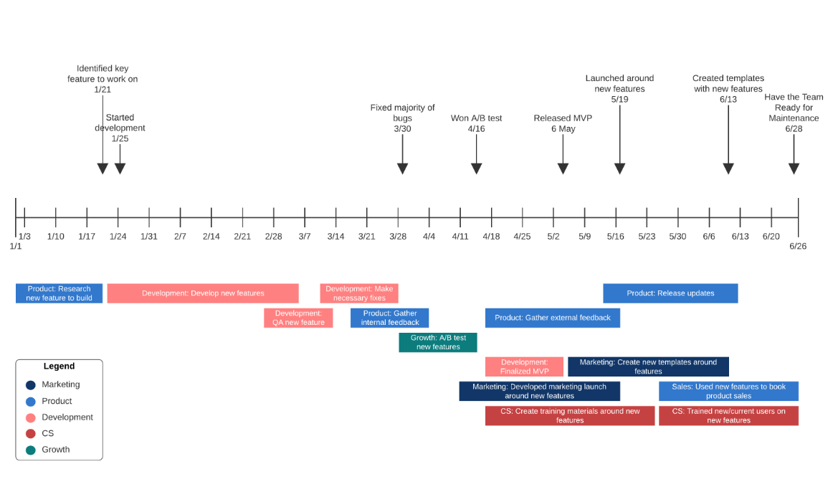
Notes:
We are going start the development process early 2021. All the key development feature should be identified by 01/21, development starts from 1/25. we will have many phases throughout the timeline over six months. Where we will take care of the bugs and features for the project. We have also identified throughout the timeline which sector of the company will be involved more to the project. Our company has few criteria which is used to determine how and where we are doing well, and which task is part of what category. There are some task which might fall under marking, some tasks are part of the product, some related to the growth of the company. Credit goes to Lucidchart for the diagram.

Slide 14
Maintenance
Once the project is done up and running, have few people from the development team constantly updating it and hire research personal for future improvements
Some key rules for the maintenance stage are listening to the help desk, Engaging QA, potentially moving to the cloud, regression testing, optimizing software maintenance team.
Notes:
Project maintenance is about tracking project activities and making sure the project is performing as expected or built for. Maintenance is one of the most important part of project development and project management.

Slide 15
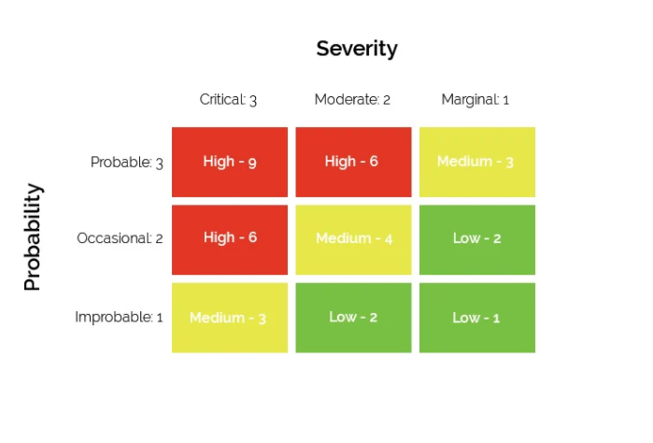
Risk Matrix
A risk matrix can also be defined as visualization for risks in a diagram. In the diagram we can use few variables to determine the severity and probability of the risk. Based on the variables we can determine risk level for certain module of the project.
Notes:
Risk management is important part of project management. Defining a clear way to address risk for each module or features for the project can help us to gain better understanding of oval risk involved developing each section of the project and address them better. In this diagram we can see how we can address risks for our project.

Slide 16
Risk Types
Financial
Social
Technical
Natural
Margin of error
Notes:
There can be many factors and variables associated with risks. To develop certain we can have financial risk, some feature might take more investment developing a then the potential revenue. We might face with issues related to social issues within the company or outside of the company developing certain features which might cause social issues. Its more often then not technical risks are involved completing a module. There are always margin for errors which can contribute to certain risks, MOE is accounted for better Risk Matrix.

Slide 17
Risk Matrix Advantages
Presents the risk visually
Risks are presented in such way for everyone's understanding.
Increases the efficiency of risk management
Helps to focus on the high priority items
Notes:
There are many advantages to risk matrix, having a well defined risk matrix can help the whole team to perform better and asses the risks properly involved in the project. We can visually show everyone how risks are presented in our project for specific component. It can help to increase the efficiency of risk management and can help to focus on priorities.

Slide 18
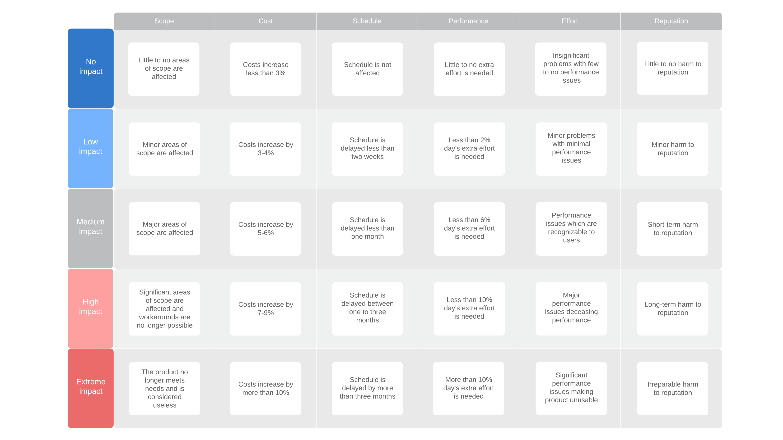
Notes:
We are going to use this risk matrix rubric to address the risks involved with our project. We are going to use them templet on every sprint of our project to identify the risk developing a feature.
Credit for the diagram goes to - app.lucidchart.com

Slide 19
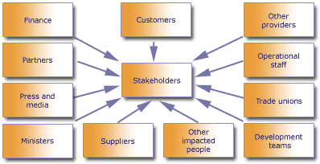
Stakeholder
Notes:
Stakeholders are the personals and organizations involved with the project. Stakeholders can be directly connected to the project with the development process or external senior level leadership team. Sponsors and customers are two main body of the stakeholders. Everyone who is part of the project plays a critical role for the project.
Finance personal oversee managing financial matters for the project. Finance project managers oversee projects that relate directly to an organization's revenue and expenses, cash flow, long-term investments, and reporting.
Business partners make sure the policies and the business is well funded and all the matters are taken care of.
It is important to have good connection with the suppliers and press & media.
Being part of the trading union helps to keep up with a strong operating unit.

Slide 20






Sponsors For Project
Notes:
Sponsors list
https://aws.amazon.com/
https://24notion.tv/
https://www.abbyy.com/company/key-facts/
https://www.darktrace.com/en/
https://dukakis.org/
These are our sponsors who will be support us financially because they see the potential in our product.

Slide 21
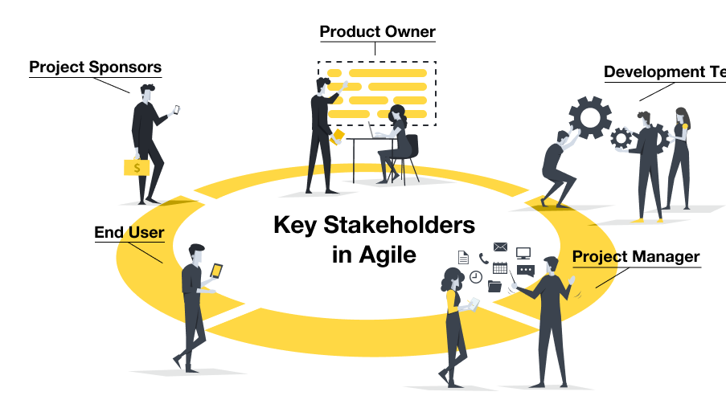
Notes:
Working on a project on a regular basis we will face all kinds of stakeholders associated with our projects. There will always be stakeholders who are leading the project actively, who knows what should be done, and the possible impacts of certain actions. There will be certain stakeholders who are unaware of many variables and the purpose of the project due to many reasons. We have worked with stakeholders who are resistant to change even though changes may bring positive change to the project. There are natural personals involved with the project who are always fine with any kind of outcome and willing to change. Finally, there are always people who are willing to take those extra steps.

Slide 22
Types of Stakeholders
Unaware - does not know about the project or its benefits and other impacts
Resistant - aware of the project and its impacts, but resistance to the change
Neutral - aware of the project, not resistant or supportive
Supportive - aware of the project, and supports the change and potential impacts
Leading - aware of the project and potential impacts, and actively ensuring its success
Notes:
As a project manager, I am fine with all kinds of stakeholders not because I want the best possible outcome for the project rather access total performance better. When I know how everyone is operating, I can help everyone to improve from wherever they are to improve their involvement if needed.
Source: The engagement classifications recommended in the PMBOK (Links to an external site.) (5th edition, see section 13.2.2.3 and the example in figure 13-7):

Slide 23
References
10 Best Artificial Intelligence Software (AI Software Reviews in 2020). (2020, June 30). Retrieved July 25, 2020, from https://www.softwaretestinghelp.com/artificial-intelligence-software/
Software Configuration Management in Software Engineering. (n.d.). Retrieved July 25, 2020, from https://www.guru99.com/software-configuration- management-tutorial.html
Step-by-Step Guide: How to Build Valuable Systems Easy. (2018, April 17). Retrieved July 25, 2020, from https://www.entrepreneurshipinabox.com/11482/step- by-step-guide-build-valuable-systems-easy/
Sahota, N. (2018, October 03). Human 2.0 Is Coming Faster Than You Think. Will You Evolve With The Times? Retrieved August 19, 2020, from https://www.forbes.com/sites/cognitiveworld/2018/10/01/human-2-0-is-coming- faster-than-you-think-will-you-evolve-with-the-times/
The credit to this templet goes to Microsoft PowerPoint

